Slide 1
Behavioral Health Solution for Children
057718 (03-16-2022)

Slide 2
Behavioral Health Care for Children
An overview of product details
About this solution | A comprehensive behavioral health solution designed to support kids, teens, and parents across a range of common family challenges.
Plan type | Self-funded only
Available | This solution is now available
Price | Contact your Premera representative for specific pricing information

Slide 3
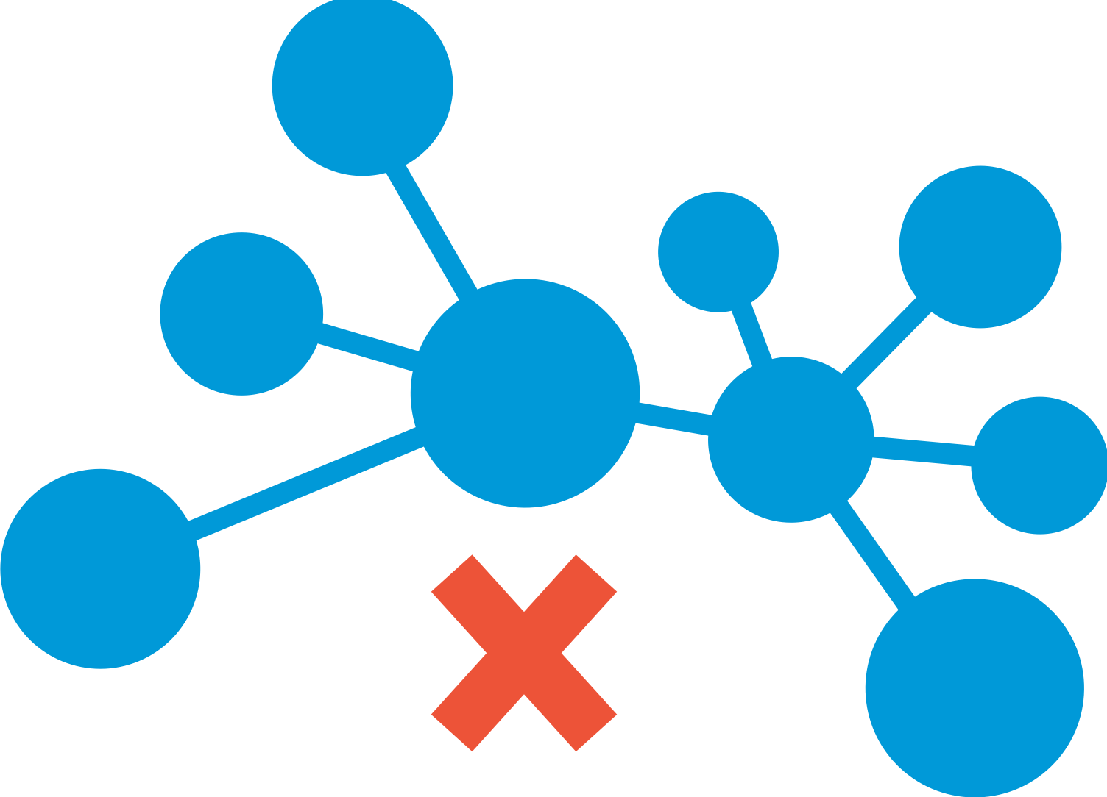
The need is undeniable
One in five children have a diagnosed mental health need.¹
80% of those diagnosed do not get the appropriate care they need.¹
Families are 10 times more likely to go out of network for pediatric behavioral health care than primary care.²
Emergency visits for pediatric behavioral health care have increased by 30% over the past year.³
1. CDC
2. Milliman 2017,
3. MMWR Morb Mortal Wkly Rep

Slide 4
It’s a challenging system
Today, your employees face many challenges when seeking pediatric behavioral support.
Access
Quality
Affordability
Stigma
Waitlists for in-network care are long and not always conveniently located.
Not all providers are high-quality.
Treatment can be expensive, especially for out-of-network options.
Like most behavioral health treatment, there is a stigma around seeking care.
Help to support your employees by providing access to common family challenges with the Premera Behavioral Health Solution for Children.

Slide 5
Behavioral Health Solution for Children
Our solution | Value
A comprehensive behavioral health solution designed to support kids, teens, and parents across a range of common family challenges such as mental health, ADHD, anxiety, depression, mood disorders, and more. Our Behavioral Health Solution for Children provides access to virtual appointments and therapy. All accessible from home, when families need it the most--even on nights and weekends. No waitlists and no closed practices. | Timely access to care amidst a shortage of pediatric behavioral health providers Convenience of bringing the right care to families right in their home during hours that work for them, including nights and weekends Education and support through self-service information and modules Seamless coordination of digital treatment programs that families can use between appointments to get help and track meaningful progress Faster care means better outcomes, improved productivity, and improved satisfaction with network access.
It's estimated that 1 in 5 children living in the United States experience a mental disorder each year.*
*Children's Mental Health Report | CDC
Notes:
*It's estimated that up to 1 in 5 children living in the United States experience a mental disorder each year. Children's Mental Health Report | CDC

Slide 6
Behavioral Health Solution for Children
Premera has partnered with Brightline to support and improve access to behavioral health for children, teens, and families.
Connect | Coaching | Care
On-the-go access to personalized content, group classes, and interactive exercises. Contact coaches instantly for tips and guidance.​ It offers: A personalized navigator to help you find the right care A structured format to reduce stress Learn about: Discussing mental health as a family Healthy social media usage in children How to encourage a spouse to seek care | Programs to help tackle everyday common challenges with expert behavioral health coaches in as few as four sessions. Tantrum management (ages 3-5 ) Stress reduction (ages 6-17) Social and emotional learning (ages 3-5) Organizational skills (ages 6-17) | Personalized behavior therapy, medication evaluation, and support from licensed Brightline clinicians. Anxiety Depression ADHD Disruptive behaviors Medication evaluation and management
Brightline is committed to getting patients into care within 5 business days.

Slide 7
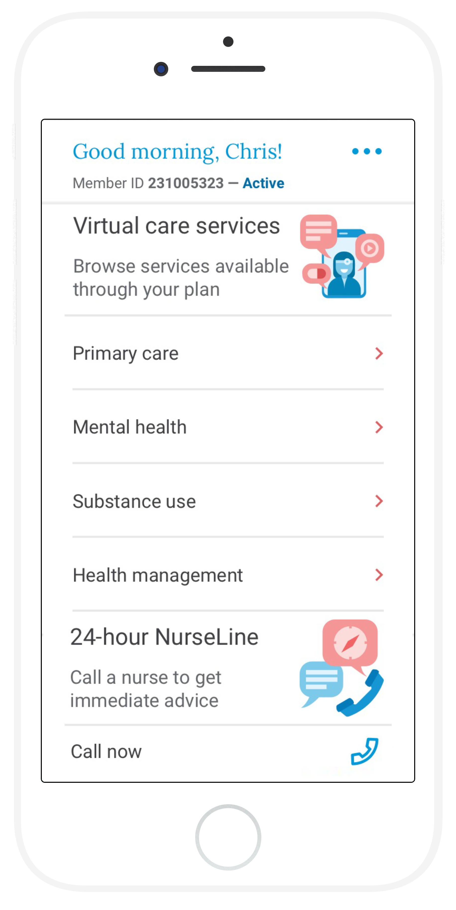
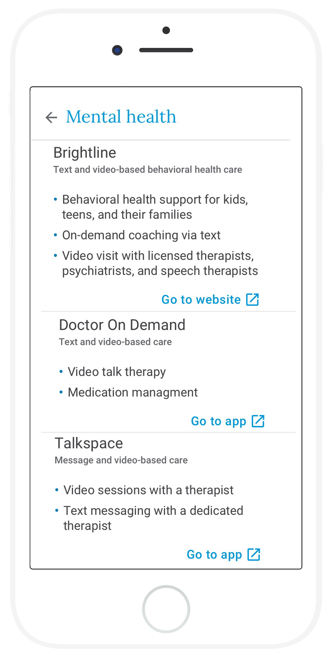
Premera MyCare
Accessing our Behavioral Health Solution Program for children has never been easier with Premera MyCare, a virtual front door that connects you to care nearly instantly.

Slide 8
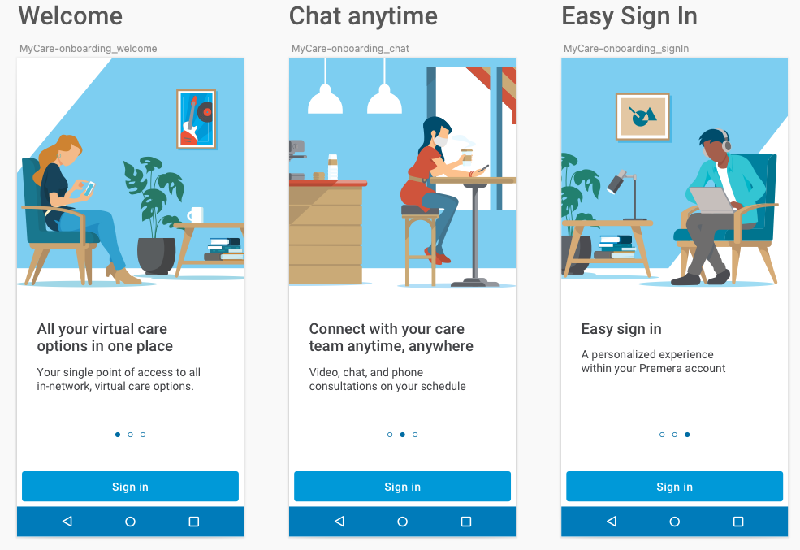
Quick and easy member sign in
1
Download MyCare from the app store
Use your Premera account login
2
3
Get connected to care in minutes!

