Slide 1
Behavioral Health Solution for Children
057717 (05-19-2022)

Slide 2
Behavioral Health Care for Children
An overview of product details
About this solution | A comprehensive, virtual behavioral health solution designed to support kids, teens, and parents across a range of common family challenges
Plan type | Self-funded only
Available | This solution is now available
Price | Contact your Premera representative for specific pricing information

Slide 3
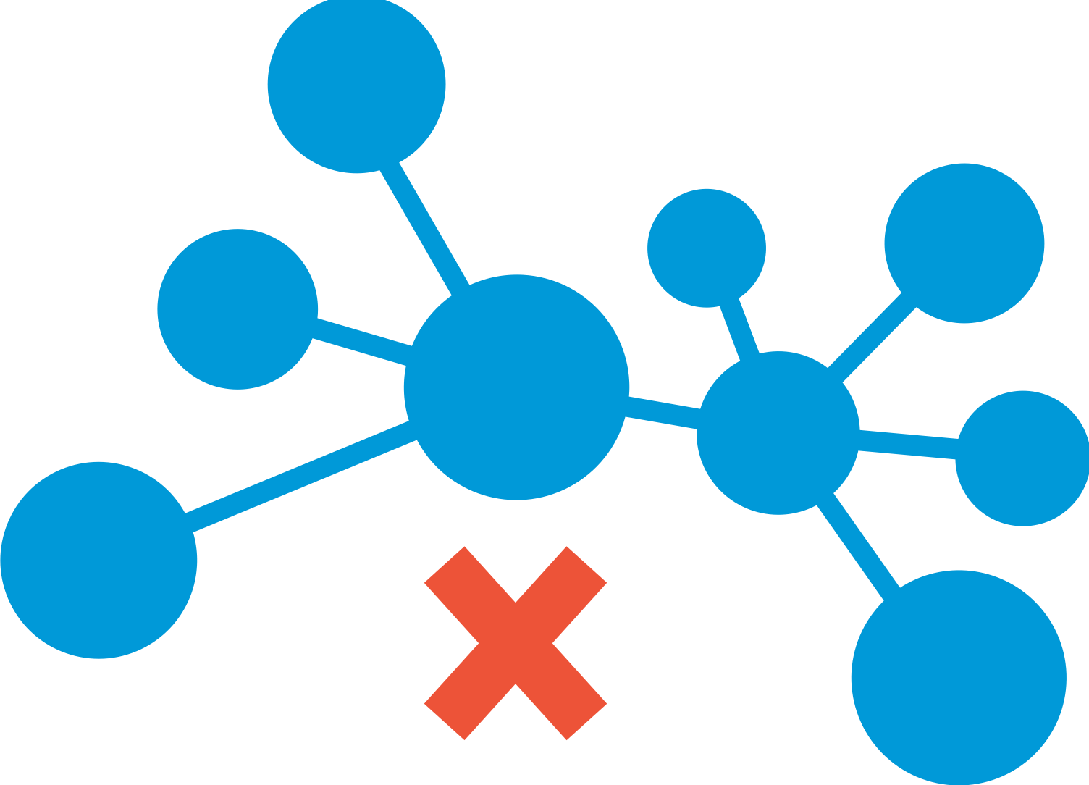
The need is undeniable
One in five children have a diagnosed mental health need.¹
80% of those diagnosed do not get the appropriate care they need.¹
Families are 10 times more likely to go out of network for pediatric behavioral health care than primary care.²
Emergency visits for pediatric behavioral health care have increased by 30% over the past year.³
CDC https://www.cdc.gov/childrensmentalhealth/access.html
Milliman 2017, https://www.milliman.com/-/media/milliman/importedfiles/ektron/addictionandmentalhealthvsphysicalhealthwideningdisparitiesinnetworkuseandproviderreimbursement.ashx
3. MMWR Morb Mortal Wkly Rep, https://www.cdc.gov/mmwr/volumes/69/wr/mm6945a3.htm

Slide 4
It’s a challenging system
Today, your employees face many challenges when seeking pediatric behavioral support.
Access
Quality
Affordability
Stigma
Waitlists for in-network care are long and not always conveniently located.
Not all providers are high quality.
Treatment can be expensive, especially for out-of-network options.
Like most behavioral health treatment, there is a stigma around seeking care.
Support your employees experiencing common family challenges by providing the Premera Behavioral Health Solution for Children

Slide 5
Behavioral Health Solution for Children
Our solution | Value
A comprehensive behavioral health solution to support kids, teens, and parents across a range of common family mental health challenges such as ADHD, anxiety, depression, mood disorders, and more. Our Behavioral Health Solution for Children provides access when families need it the most—even on nights and weekends through virtual appointments. No waitlists and no closed practices. | Timely access to care amidst a shortage of pediatric behavioral health providers Convenience of bringing the right care to families right in their home during hours that work for them, including nights and weekends Education and support through self-service information and modules Seamless coordination of digital treatment programs that families can use between appointments to get help and track meaningful progress Faster care means better outcomes, improved productivity, and improved satisfaction with network access.
It's estimated that 1 in 5 children living in the United States experience a mental disorder each year.*
*Children's Mental Health Report | CDC
Notes:
*It's estimated that up to 1 in 5 children living in the United States experience a mental disorder each year. Children's Mental Health Report | CDC

Slide 6
Behavioral Health Solution for Children
Premera has partnered with Brightline to support and improve access to behavioral health for children, teens, and families.
Connect | Coaching | Care
On-the-go access to personalized content, group classes, and interactive exercises. Contact coaches instantly for tips and guidance.​ It offers: A personalized navigator to help you find the right care A structured format to reduce stress Learn about: Discussing mental health as a family Healthy social media usage in children How to encourage a spouse to seek care | Programs to help tackle everyday common challenges with expert behavioral health coaches in as few as four sessions. Tantrum management (ages 3-5 ) Stress reduction (ages 6-17) Social and emotional learning (ages 3-5) Organizational skills (ages 6-17) | Personalized behavior therapy, medication evaluation, and support from licensed Brightline clinicians. Anxiety Depression ADHD Disruptive behaviors Medication evaluation and management
Brightline is committed to getting patients into care within 5 business days.

Slide 7
Pricing
Brightline Connect+ Content | Brightline Coaching Programs | Brightline Care Therapy
Interactive digital content collections Educational classes, peer support groups Coach chat for guidance through resources and triage support | 1:1 video visits with Board Certified BH coaches Short-duration programs for skill-building For families with sub-clinical needs or not ready for therapy | 1:1 video visits with therapists, prescribers and speech-language pathologists Personalized care plans grounded in evidence Clinical measurement and progress tracking
$35 per active participant per month (6-month episode)* | $90 per coaching session* | Runs through claims
*Note to employers: We encourage our self-funded employers to consider the tax implications associated with the Coaching and Connect pillars of the Brightline offering. Generally speaking, Coaching and the Connect platform are not considered to be medical care as defined by the IRS, but these services may be considered as taxable income to the employee. Self-funded employers should seek legal advice regarding the potential tax consequences, as Premera’s legal team cannot provide legal advice to employer groups.

Slide 8
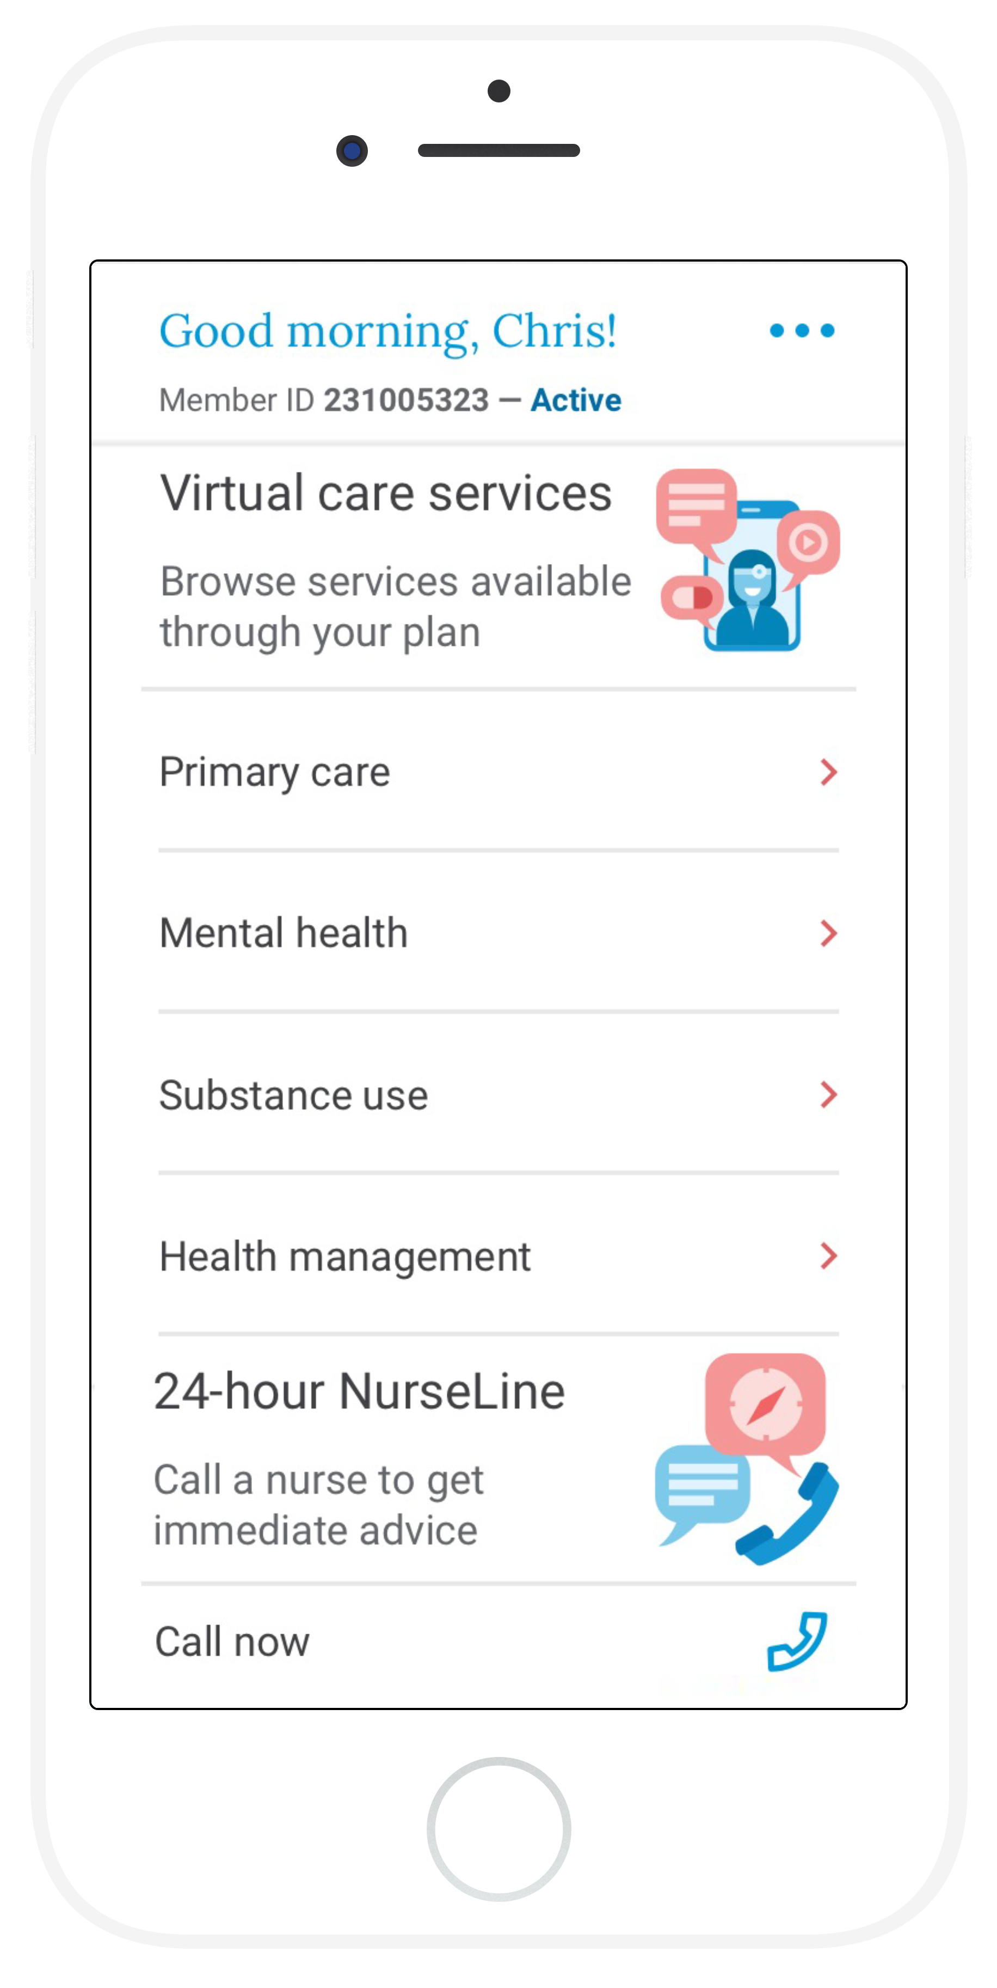
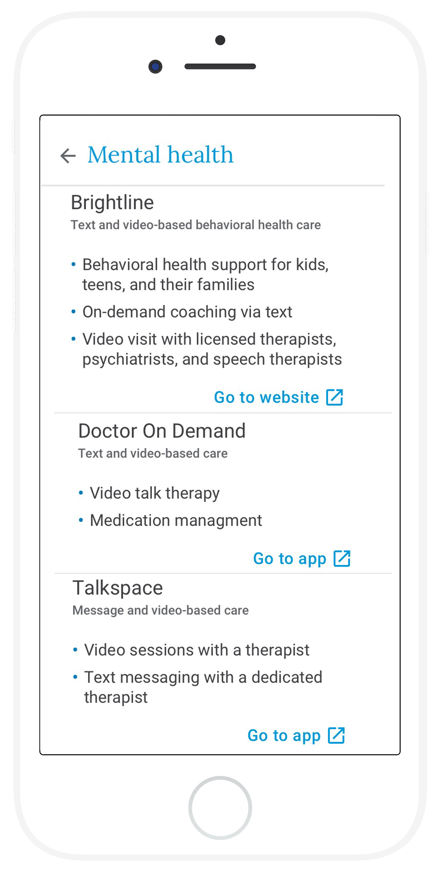
Premera MyCare
Accessing our Behavioral Health Solution Program for children has never been easier with Premera MyCare, a virtual front door that connects you to care nearly instantly.

