Slide 1

How to use
this template
There are some variables in this deck.
Words that have green highlight need to be filled in.
Words or slides that have a yellow highlight are optional and should be deleted if they do not apply.
Underlined content are hyperlinks to online resources.
Please delete this slide before sharing.
This is a fully customizable template for use in-person or virtually. It can also be saved as a PDF for electronic distribution.
053398 (10-03-2024)

Slide 2
Group Name
Open Enrollment
Month Year

Slide 3
Agenda | Topics
About Premera Blue Cross Blue Shield of Alaska
Health plan basics
XXXX plans
XXXX benefits
Member experience
Enroll now

Slide 4
About Premera
Making healthcare work better

Slide 5


Healthcare for all your ages and stages
Life is full of meaningful moments and milestones
When those moments include a change to your health needs, you’ll be prepared for whatever life brings with an award-winning health plan in your corner. You can be confident knowing you have access to quality care and plenty of ways to find it.
When your needs do change, you can feel secure knowing you chose the right health plan to serve you best at all stages of your life.
Every day we aim to improve customers’ lives by making healthcare work better. We’re Premera Blue Cross Blue Shield of Alaska.
See how we show up for our communities at premera.com

Slide 6

About Premera Blue Cross Blue Shield of Alaska
We take everything we’ve learned in over 90 years and put it to work taking care of you
Part of the Blue Cross Blue Shield Association
One of the 33 health plans that makeup the oldest and most experienced healthcare coverage providers in the United States
Largest health plan in the Pacific Northwest
Serves over 2.8 million members across the United States—from individuals and families to employees of Fortune 100 companies
Provides network access to doctors and hospitals across the country
Invested in local communities
Our investments focus on tackling the root cause of issues related to behavioral health and homelessness, rural healthcare, and health inequities.
Since 2017, Premera Social Impact more than $100M through 484 grants reaching every county in Washington and every region in Alaska.
See why 1 in 3 Americans are covered by a blue plan

Slide 7
What we provide
Access to the largest network in the United States¹
95% of providers and 96% of hospitals in network
Diverse virtual care options
Access to robust dental network
60,000+ dentists nationwide
State-of-the-art mobile app, digitals tools, and resources
Award-winning customer service²
Best case management in the country³
¹ BlueCard® PPO
² Premera was recognized at HIMSS in 2019, winning the Microsoft for Healthcare Innovation Award for Patient Engagement.
³ National Committee for Quality Assurance (May 2019)

Slide 8
Health plan basics
The nuts and bolts of health plans

Slide 9


What is a health plan?
The plan you choose determines how much you pay, when you pay, and where you can get care.
Member
Health plan
Providers
Seeks medical care
Provides benefits and
access to health care
Provides medical, dental, and pharmacy services
Learn more about how health plans work

Slide 10

Who pays for what?
Premium (paycheck contribution): the amount you pay for your health plan every month.
Coinsurance: your share of the costs after you pay your deductible. You may only have coinsurance and no copays – plans vary.
Copay: a set fee you pay when you visit the doctor or emergency room or get a prescription filled. You may only have copays and no coinsurance – plans vary.
Deductible: the amount of money you pay before your plan starts paying.
Out-of-pocket maximum: the maximum amount you pay out of pocket for covered health care services in a plan year.
YOU PAY
WE BOTH PAY
WE PAY
non-preventive care and prescriptions until you reach deductible
coinsurance for covered services
100% covered services
START PLAN YEAR
YOU PAY $0
DEDUCTIBLE MET
OUT-OF-POCKET MAXIMUM MET
View types of plans on premera.com

Slide 11
Where to seek care
We negotiate with high-quality providers to give you the best care at a reasonable price.
In-network = $
Out-of-network = $$$
Hospitals and Clinics
Virtual Care
Each plan offers a specific group of doctors, pharmacies, hospitals, and other healthcare providers you can use at a contracted price—that’s your network. Because you pay a portion of the costs of your medical care, it’s important to know that you will typically pay less when seeing an in-network provider. Services from out-of-network providers may cost more, do not apply toward your deductible, and may not be covered by your plan at all.
You save money by seeing in-network providers

Slide 12
Year plans
You plan choices

Slide 13
Premera benefits
OPTIONAL SLIDE
Starting <Effective Date>, Premera will administer these benefits for <Company Name>:
Medical plans
Plan 1
Plan 2
Plan 3
Dental plans
Plan 1
Plan 2
Pharmacy
Formulary

Slide 14
Plan <Name> and Plan <Name>
OPTIONAL SLIDE
Plan <Name>
Network: <Name>
Network alert:
EX: Only virtual care and emergency care are available out of state
Features:
EX: No referrals for specialty care
EX: Same-day appointments
Plan <Name>
Network: <Name>
Network alert:
EX: Only virtual care and emergency care are available out of state
Features:
EX: No referrals for specialty care
EX: Same-day appointments

Slide 15
Plan comparison
OPTIONAL SLIDE
 | Plan 1 | Plan 2 | Plan 3
Network | <Name> | <Name> | <Name>
Premium Individual / Family
Deductible Individual / Family
Pharmacy deductible Individual / Family
Out-of-pocket maximum Individual / Family
Coinsurance
Pharmacy | Retail 30-day | Mail order 90-day | Retail 30-day | Mail order 90-day | Retail 30-day | Mail order 90-day
Preferred generic (deductible waived) Preferred brand Preferred specialty Non-preferred drugs

Slide 16
Plan comparison
OPTIONAL SLIDE
 | Plan 1 | Plan 2 | Plan 3
Office visit Includes naturopathy services
Preventive care Includes vaccinations | 100% | 100% | 100%
Mental health care Office visit
Laboratory services Includes x-ray, imaging
Alternative care Includes chiropractic, massage, acupuncture
Virtual care General medicine, dermatology, mental health
Emergency care

Slide 17
Choosing the right plan
SMALL GROUP – Edit or delete as needed
 | Bronze/Bronze+ | Silver | Gold/Platinum
Network | <Name>
Payroll deduction | $ | $$ | $$$
Coinsurance/copay
Deductible | $$$ | $$ | $
HSA eligible
Tax benefits
Things to consider:
Who will be covered under your plan?
What are your medical needs?
How and when do you want to pay for care?
All plans cover preventive care in full – visit premera.com for information

Slide 18
Choosing the right plan
LARGE GROUP – Edit or delete as needed
 | Plan 1 | Plan 2 | Plan 3
Network | <Name> | <Name> | <Name>
Payroll deduction | $ | $$ | $
Coinsurance/copay
Deductible
HSA eligible
Tax benefits
Things to consider:
Who will be covered under your plan?
What are your medical needs?
How and when do you want to pay for care?
All plans cover preventive care in full – visit premera.com for information

Slide 19

Dental
OPTIONAL SLIDE
Healthy oral habits are linked to overall health
The Dental Choice provider network includes:
60,000+ dentists nationwide
What’s included
Comprehensive care that covers common dental needs
Waivable deductible for preventive care
A dental plan’s annual maximum is different from that of medical plans, which have an out-of-pocket maximum. A dental annual maximum is the total your dental plan will pay toward your care during any one plan year.
Visit premera.com/dentalhealth to find a dentist and get cost estimates

Slide 20

Pharmacy
OPTIONAL SLIDE
Your health plan provides coverage for prescription medications
When you fill a prescription at the pharmacy, you pay a designated copay or coinsurance (the fixed amount you pay at the time of service). Your copay or coinsurance depends on which tier, or level, the drug is assigned to.
Ways you can save
Go generic – Ask your doctor or pharmacy about equally effective alternatives. Your plan compares discount card prices to the regular plan price on certain generic drugs—and you get the lowest cost. Payment applies toward your annual deductible and out-of-pocket maximum. No need to sign up. Discount applied automatically.
Use mail order – Skip the line at the pharmacy and get a 90-day supply delivered to your home from Express Scripts Pharmacy.
Rx Savings Solutions – Get alerts when you’re spending too much on prescriptions and compare drug costs.
Rx Savings Solutions is an independent company that provides prescription discount services on behalf of Premera Blue Cross.
Check out our Pharmacy Benefit Guide on premera.com

Slide 21


Rx Savings Solutions
OPTIONAL SLIDE
Lower your prescription drug costs today
This free benefit helps you and others on your plan easily find the lowest-price option for prescription drugs.
How it works
Check out what lower-cost prescriptions may be available under your health plan and compare prices at different pharmacies
Rx Savings Solutions will handle everything with your doctor and pharmacy to switch your prescription to a lower-cost pharmacy.
You’ll receive an email (or text message if you opt in to receive texts) any time you can spend less, taking the burden off you to find the lowest price on your medications.
Activate your account at myrxss.com/premera
Rx Savings Solutions is an independent company that provides prescription discount services on behalf of Premera Blue Cross.

Slide 22
Pharmacy glossary
OPTIONAL SLIDE
Formulary: a list of covered drugs.
Nonformulary: medications that aren’t on the preferred drug list, often due to efficacy and/or price.
Brand name: a patented prescription drug that is produced by a single manufacturer.
Generic: a chemically equivalent—but often less expensive—copy of a brand name drug for which the patent has expired.
Single-source drug: a drug that is patented and produced by a single manufacturer.
Over-the-counter drug: a retail drug product that does not require a prescription under federal or state law, often called OTC.
Mail-order drugs: programs that deliver your maintenance drugs directly to you by mail for a reduced cost
Tiers: drug coverage levels that determine what you pay out of pocket for your prescriptions. These commonly include generic drugs, brand-name drugs, non-preferred/low-value drugs, and/or specialty drugs.

Slide 23

Vision
OPTIONAL SLIDE
Your health plan comes with a vision benefit
Annual preventive vision exams are covered in full when you see an in-network provider. And if you need contacts, eyewear, or other low-vision devices, those are covered, too.
Your vision benefit
Exam copay: <copay>
Your plan allows <number> vision exam(s) every <frequency>
Hardware allowance: <dollar amount> every <frequency>
To find an in-network provider, visit premera.com

Slide 24

Find care
We make it easy to find in-network providers and hospitals
If you are a current member, sign in to your Premera account online or on the Premera app.
Browse by category:
Primary care
Mental & behavioral health
Urgent care clinics
Hospitals
Services/procedures
Not a member? To see if your doctor is in your plan network, visit premera.com, select “Find Care”, and search under “Employer-based plans”.
There are many Premera networks, so be sure to select your plan’s specific network from the menu. If you don’t know the network name, ask your plan administrator or HR.
You save money by seeing providers in your plan network.

Slide 25


Year benefits
Your benefits and services

Slide 26

Preventive care
Stay healthy with annual checkups and screenings for the whole family
Preventive care helps keep you healthy and can catch potential health issues while they are easier to treat.
In-network preventive care is 100% covered (free to you) and includes:
Annual checkups with a primary care doctor
Routine bloodwork
Cancer screenings
Vaccinations
Visits, screenings, or tests used to check out a sign, symptom, or health concern are considered diagnostic and are not covered as preventive. To avoid surprise costs, ask your doctor if the service is preventive.
For more information about preventive care, visit premera.com

Slide 27






Preventive care
Replace QR codes
¡Explora nuestra página en español! Encontrarás información acerca de sus beneficios, el cuidado preventivo y cómo aprovechar de su plan de salud.
According to the Centers for Disease Control and Prevention (CDC), preventive care services could save over 100,000 lives in the United States Every year.* Checkout these helpful videos about the value of preventive care.
Choose a primary care provider
Book a preventive care visit
Understand preventive care visits
* “The Value of Preventive Care.” The Washington Post, WP Company, 26 Jan. 2022, https://www.washingtonpost.com/brand-studio/wp/2019/11/25/feature/the-value-of-preventive-care/
For more information about preventive care, visit premera.com

Slide 28

24-Hour NurseLine
Healthcare advice is just a phone call away
It’s after hours, and you have pain, an injury, or a fever that just won’t go down. Who can help you decide what to do?
With the 24-Hour NurseLine, advice is just a phone call away—24 hours a day, 7 days a week, 365 days a year.
When you call the 24-Hour NurseLine:
Your call is answered quickly by a registered nurse.
The nurse asks you the right questions and helps you decide what to do.
Your call is free and confidential
The phone number for the 24-Hour NurseLine is on the back of your ID card

Slide 29

Personal Health Support
Free guidance and support
If you or a family member is diagnosed with a serious illness or condition, or suffers from a serious injury, the personal health support program can provide extra support at no extra cost.
Personal health support can:
Find resources for your health and recovery
Coordinate care and services to help get the best treatment
Navigate the complex healthcare system
A team of registered nurses, certified dieticians, and licensed mental health professionals are ready to help.
Call Personal Health Support at 888-742-1479 (TTY: 711)

Slide 30
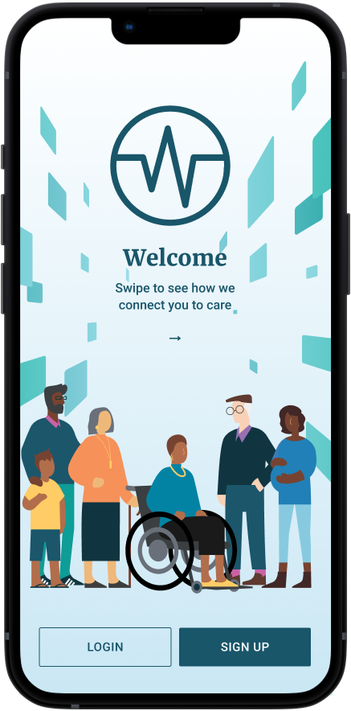
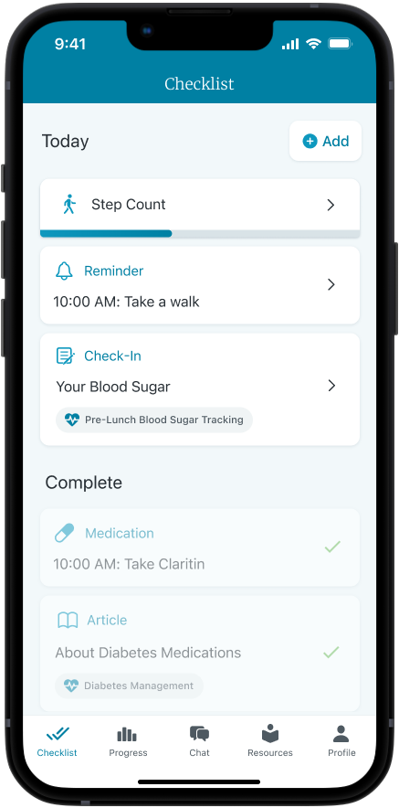



OPTIONAL SLIDE
Wellframe
A free digital resource to help you achieve your health goals
The mobile health program includes:
Help navigating the healthcare system
Mental health support
Medication and pain management
Exercise and sleep trackers
Nutrition guidance
And more
If you have a chronic condition, such as diabetes, a heart condition, or mental health condition, a personal support clinician will connect with you through the app to help you manage a new diagnosis or reach your health goals.
This benefit is included with your health plan at no extra cost. Download Wellframe now.
Download the Wellframe app
Scan the QR code to download the app from the App Store or Google Play.
Enter code: helpwellpbc if the access code doesn’t autofill.
Enter your Premera member ID number found on your ID card.
Follow the instructions to complete your registration.
For more information, visit wellframe.com/members

Slide 31
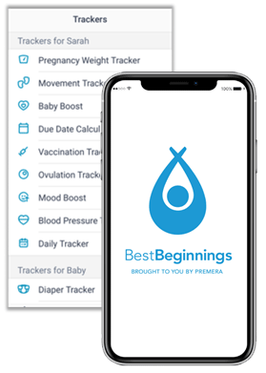

OPTIONAL SLIDE
BestBeginnings
Support for pregnancy, delivery, postpartum care, and newborn care
Extra clinical support from your health plan
You may be eligible for some extra support if you:
Are expecting multiples
Have had a premature baby
Are over 35
Have other pregnancy risk factors
Our maternity specialists are licensed clinicians who know your health plan and can answer pregnancy questions.
Contact a maternity specialist at 855-756-0797.
For helpful information about pregnancy and childbirth, you have two online resources from Premera:
Healthsource blog
Guide to care decisions
The BestBeginnings app
Supports you through your family planning and fertility journey
Tracks pregnancy and early childhood milestones up to age 2
Prep questions for your doctor visits
Log your health history and test results
Discover Premera benefits and resources
Find out more about important symptoms and issues during pregnancy
Stay organized with trackers for diaper changes and feeding after your baby arrives
For more information about fertility and pregnancy benefits, visit premera.com

Slide 32
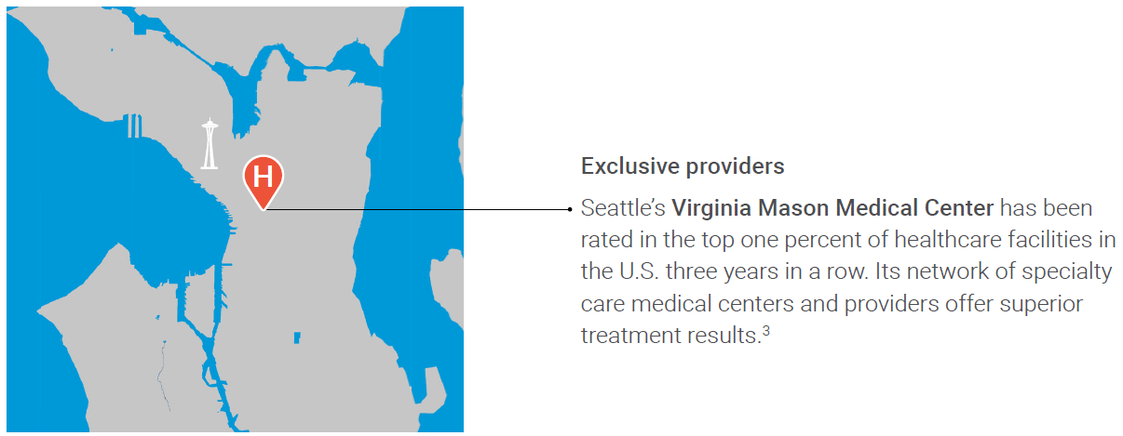
OPTIONAL SLIDE – Virginia Mason
High-value specialty care benefit
Premera-Designated Centers of Excellence
Your Premera health plan offers low- to no-cost surgeries from select surgeons for total knee and hip replacement, spine surgery, and certain gynecological procedures.
Exclusive benefits:
You pay $0 toward the cost of care when your deductible is met.
Travel expenses are covered for you and a care companion when you travel to Virginia Mason Medical Center*
Your appointments are scheduled by our concierge service. They will also transfer your medical records and make your travel arrangements.
*Available on select Premera plans; benefit may vary. Travel expenses in excess of IRS limits may result in taxable interest to you.
To see if you qualify, call Personal Health Support at 888-742-1479 (TTY: 711)

Slide 33
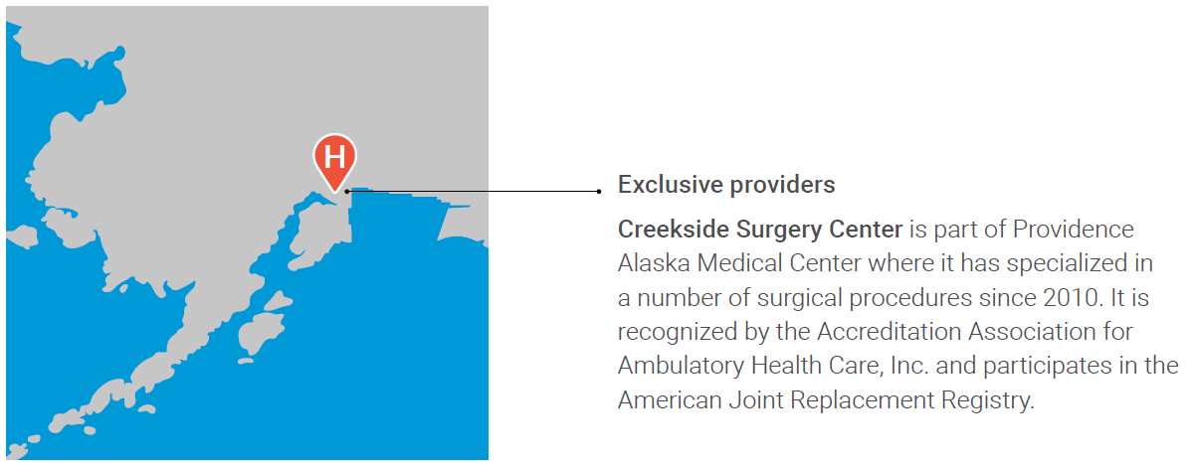
OPTIONAL SLIDE – TJR BUNDLE
Total joint replacement surgery benefit
Premera-Designated Centers of Excellence
Your Premera health plan offers low- to no-cost surgeries from select surgeons at designated hospitals for total knee and hip replacement.
Exclusive benefits:
You pay $0 toward the cost of care when your deductible is met.
Travel expenses are covered for you and a care companion when you travel to one of our Premera-Designated Centers of Excellence (COE) that is over 50 miles from your home.*
Your appointments are scheduled by our concierge service. They will also transfer your medical records and make your travel arrangements.
*Available on select Premera plans; benefit may vary. Travel expenses in excess of IRS limits may result in taxable interest to you.
To see if you qualify, call Personal Health Support at 888-742-1479 (TTY: 711)

Slide 34
OPTIONAL SLIDE – SELF FUNDED LARGE GROUP
Total joint replacement surgery benefit
Premera-Designated Centers of Excellence
This health plan offers low- to no-cost surgeries from select surgeons at designated hospitals for certain high-cost specialty procedures.
Exclusive benefits:
You pay $XX toward the cost of care when your deductible is met.
Travel expenses are covered for you and a care companion when you travel to one of our Premera-Designated Centers of Excellence (COE) that is over 50 miles from your home.*
Your appointments are scheduled by our concierge service. They will also transfer your medical records and make your travel arrangements.
Each hospital has a proven record of exceptional patient experience and surgical outcomes for:
Bariatric surgery
Cancer care
Cardiac care
Cellular
immunotherapy
Fertility care
Gene therapy
Maternity
Spine surgery
Substance use treatment and recovery
Total hip replacement
Total knee replacement
Transplants
*Available on select Premera plans; benefit may vary. Travel expenses in excess of IRS limits may result in taxable interest to you.
To see if you qualify, call Personal Health Support at 888-742-1479 (TTY: 711)

Slide 35
OPTIONAL SLIDE
Coverage near and far
 | Air ambulance | Medical access transportation | Elective procedure travel | Premera-Designated Centers of Excellence
Uses | Airlift in emergency situations | Medically-necessary care when you don’t have a local in-network provider | Hundreds of planned non-emergency surgeries and medical procedures | Specialized services like gynecological procedures, spine surgery, and total joint replacement (knee and hip)
Facilities | Closest suitable facility within the U.S. | In Alaska (or Seattle if that’s the closest in-network provider to you) | In-network providers in the continental U.S. | A high-quality facility in Seattle
Benefits | Transport by licensed ambulance for member who needs care Medical care during the trip In-network cost share* | Travel within Alaska (or to Seattle if that’s the closest in-network provider to you) | Roundtrip airfare for you and a travel companion Hotel accommodations Ground transportation Medical records transfer Care coordination with the specialist facility | Roundtrip airfare for you and a travel companion Hotel accommodations Ground transportation Medical records transfer Care coordination with the specialist facility Benefit is paid in full on PP plans

Slide 36
OPTIONAL SLIDE
Travel benefits for gender-affirming care
Making healthcare possible when you need it
Wanting to seek gender-affirming care but live in a state where services are restricted? Find out about how we put your health first by covering travel to states where you can get the care you need.
Who is eligible
You can be reimbursed for travel to get gender-affirming care if you:
Are covered by a participating Premera health plan
Live in a state that restricts these services at the time care is needed
What is covered
When you travel to get gender-affirming care, you can be reimbursed for:
Round-trip commercial airfare for yourself (plus a companion if medically necessary or to accompany a minor)
Hotel accommodations
Airport parking
Private car mileage (if traveling over 50 miles)
Hospital or clinic parking
Ground transportation between airport, hotel, and hospital or clinic
Note: Subscriber is responsible for expenses in excess of IRS limits.
For more information, go to irs.gov/pub/irs-pdf/p502.pdf.
Call customer service at 800-508-4722 (TTY: 711) for more information

Slide 37
OPTIONAL SLIDE
Travel benefits for abortion services
Making healthcare possible when you need it
Thinking about ending your pregnancy but live in a state where abortions are restricted? Find out about how we put your health first by covering travel to states where you can get the care you need.
Who is eligible
You can be reimbursed for travel to get an abortion if you:
Are covered by a participating Premera health plan
Live in a state that restricts abortion services at the time care is needed
What is covered
When you travel to get an abortion, you can be reimbursed for:
Round-trip commercial airfare for yourself (plus a companion if medically necessary or to accompany a minor)
Hotel accommodations
Airport parking
Private car mileage (if traveling over 50 miles)
Hospital or clinic parking
Ground transportation between airport, hotel, and hospital or clinic
Note: Subscriber is responsible for expenses in excess of IRS limits.
For more information, go to irs.gov/pub/irs-pdf/p502.pdf.
Call customer service at 800-508-4722 (TTY: 711) for more information

Slide 38




OPTIONAL SLIDE
Virtual primary care
Get care today or 24/7 for any non-emergency
Doctor On Demand allows you to skip the waiting room and meet directly with board-certified physicians 24/7, 365 days a year by video. Connect virtually through a mobile app and get the care you need on your schedule.
Download Premera MyCare and sign in with your Premera account.
CirrusMD and Doctor On Demand are independent companies that provide virtual medical care services on behalf of Premera Blue Cross Blue Shield of Alaska.
Care wherever you are by phone, video, or text

Slide 39

OPTIONAL SLIDE
Premera MyCare
Your virtual front door to care
Premera MyCare is a single-point of access to the virtual care providers available to you. This means you and your enrolled dependents can get the care you need whenever and wherever.
Why wait to feel better?
Many providers offer care 365 days a year
Avoid the hassle, wait, and cost of in-person care
Care for a variety of needs including primary care, mental health, substance use, diabetes management, physical therapy, and more*
Download Premera MyCare and sign in using your Premera account.
*Not all virtual care options are available on all plans. Sign in to Premera MyCare to view your available virtual care providers.
Care wherever you are by phone, video, or text

Slide 40

OPTIONAL SLIDE
Virtual mental health care
Get care for anxiety, depression, postpartum depression, relationship counseling, trauma and loss, and more.
Talkspace connects you with mental health professionals via text or video at any time of day, anywhere you are. Talkspace provides a secure, virtual care experience in the palm of your hand with an easy-to-use app, which makes therapy and mental health support only a click away.
Doctor On Demand provides access to mental health care on the go without the hassle of dealing with traffic on your way to a professional. Therapy with Doctor On Demand is as easy as taking a video call on your phone, tablet, or laptop in between work or errands.
Download Premera MyCare and sign in using your Premera account.
Talkspace and Doctor On Demand are independent companies that provide virtual medical care services on behalf of Premera Blue Cross Blue Shield of Alaska.
Visit premera.com/mentalhealth for resources and help

Slide 41

OPTIONAL SLIDE
Getting mental health care
1 in 3 adults report experiencing symptoms of depression or anxiety right now (source)
Finding the best psychiatrist, mental health therapist or substance use therapist can be challenging. With access to in-person care and virtual options – you can find the care that works for you.
Your virtual care providers include:
Doctor On Demand for a video chat with a doctor for medical care or mental health therapy.
Talkspace for virtual access to licensed therapists.
Boulder Care for video-based treatment of addiction and substance abuse.
WorkIt Health for video-based treatment of addiction and substance abuse.
Visit premera.com/mentalhealth for resources and help

Slide 42

OPTIONAL SLIDE
End the stigma around mental health
It’s time to talk openly about getting care
People often avoid mental healthcare for fear that others will judge them. They don’t want to be defined by a diagnosis or seen differently. We can all play a role in ending the stigma.
Share your own stories of mental health struggles and getting care.
Avoid using hurtful words or jokes about what someone is going through.
Be an ally and call out this behavior when you hear others using these terms.
Checkout the conversations happening at premera.com/mentalhealth

Slide 43
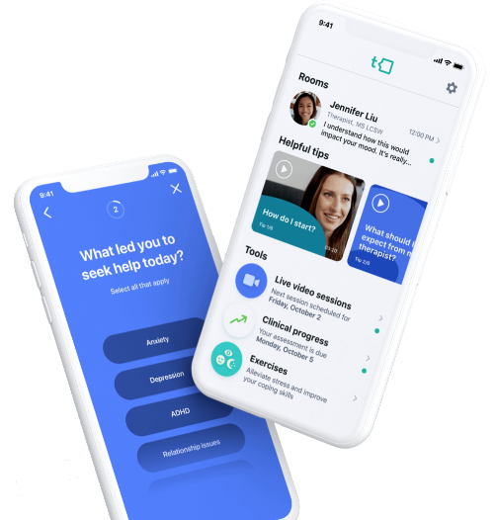
OPTIONAL SLIDE
Talkspace
Talkspace provides easy access to therapists through live, face-to-face video appointments and text messaging.
Convenient, personalized care Members can text with their therapist or schedule a live video appointment as needed, and they are paired with the same therapist each time. Building a relationship with your provider is the cornerstone of effective mental health care, which is how Talkspace makes its virtual support just as accessible and thorough as in-person sessions, if not more.
Regular responses Therapists respond 1–2 times per day. If you need more, you can simply schedule a video chat. Their goal is to help you whenever you need it, whether you have a simple question about a diagnosis or medication, or you’re having a crisis or panic attack and need professional attention.
Advanced customer support Customer Support can help answer non-clinical questions about how Talkspace works. Customer support is not able to answer questions about sensitive PPI such as issues pertaining to your medication and/or mental health care, support, or treatment.
Talkspace is an independent company that provides virtual medical care services on behalf of Premera Blue Cross Blue Shield of Alaska.
Visit talkspace.com/premera to get started

Slide 44

OPTIONAL SLIDE
Virtual substance use disorder treatment
Boulder Care focuses on empathy, kindness, respect, and unconditional support. Boulder Care customizes your treatment to your needs and schedule, tailoring it to your unique circumstances. If you have an alcohol or substance use disorder (SUD), Boulder Care offers coordinated outpatient care, including prescriptions, delivered through a secure and private app on your phone. (Medication Assisted Treatment is limited to the following states: Alaska, Colorado, Idaho, North Carolina, Ohio, Oregon, Utah, and Washington.)
Workit Health treats alcohol, cigarettes, or drugs addiction from the security of your own home. Workit Health provides extensive support and treatment options for you or a loved one struggling with substance abuse, including digital rehab and virtual check-ins with your own clinician. (Medication Assisted Treatment is limited to the following states: Michigan, New Jersey, Ohio, Florida, and Texas.)
Boulder Care and Workit Health are independent companies that provide virtual medical care services. on behalf of Premera Blue Cross Blue Shield of Alaska.
Stop the cycle with virtual treatment, visit premera.com to learn more

Slide 45


MatchmakerTM for Behavioral Health
OPTIONAL SLIDE
One in three adults report experiencing symptoms of depression or anxiety right now (source). Change, uncertainty, and new ways of going about our daily lives can take a toll, and yet finding a mental health provider who is accepting new patients can be hard.
That’s why we offer MatchmakerTM for Behavioral Health, a program that connects you to outpatient mental health providers based on:
Your health plan
Your care needs
In-person or virtual availability
And your unique preferences
You’ll receive a curated list of providers that meet your criteria and are accepting new patients. This program is free to you and your covered family members.
Call customer service at < CS PHONE> to request help finding a provider.
For additional resources, visit premera.com/mental-health

Slide 46

OPTIONAL SLIDE
Virtual physical therapy
Omada for Joint & Muscle Health offers a virtual alternative to in-person physical therapy. Whether you’re looking to build strength, reduce pain, or improve flexibility, Omada provides extensive resources to help you feel better.
Clinically validated - numerous studies have proven the clinical benefit of remote physical therapy, and the results from Omada have been industry-leading.
Licensed physical therapists – Omada holds themselves to high standards when they hire their physical therapists (PTs). They ensure the best outcomes for their patients.
Responsible care - you’ll be assigned a PT who’s focused on your unique needs, schedule, and body type, and they’ll be with you every step of the way through your recovery.
Omada for Joint and Muscle Health is an independent company that provides virtual medical care services. on behalf of Premera Blue Cross Blue Shield of Alaska.
Get moving and back on track with virtual physical therapy

Slide 47

OPTIONAL SLIDE – DIABETES MANAGEMENT PROGRAM
Teladoc Health
Teladoc Health is a personalized program to help you manage diabetes. Your plan covers the cost of the program, it’s completely free to you.
When you join, you’ll get:
An advanced meter with real-time support, tips, and a health summary report you can share with providers
Unlimited strips and lancets shipped directly to you automatically based on your usage
Personalized coaching including real-time support of high or low readings by phone, text, or email
Livongo is an independent company that provides virtual medical care services. on behalf of Premera Blue Cross Blue Shield of Alaska.
Join now and take control of diabetes at TeladocHealth.

Slide 48

OPTIONAL SLIDE – DIABETES MANAGEMENT PROGRAM
Teladoc Health
Teladoc Health is a personalized program to help you reach your health goals. Your plan covers the cost of the program, it’s completely free to you.
When you join, you’ll get:
An advanced smart scale and app
Unlimited one-on-one expert coaching
Guidance on creating health habits that last
All-in-one weight, activity and food tracking
Livongo is an independent company that provides virtual medical care services. on behalf of Premera Blue Cross Blue Shield of Alaska.
Take control of your health, join now at TeladocHealth.

Slide 49

OPTIONAL SLIDE – WEIGHT MANAGEMENT PROGRAM
Teladoc Health
Teladoc Health is a personalized program to help you reach your health goals. Your plan covers the cost of the program, it’s completely free to you.
When you join, you’ll get:
An advanced smart scale and app
Unlimited one-on-one expert coaching
Guidance on creating health habits that last
All-in-one weight, activity and food tracking
Livongo is an independent company that provides virtual medical care services on behalf of Premera Blue Cross.
Take control of your health, join now at TeladocHealth.

Slide 50

OPTIONAL SLIDE – HYPERTENSION MANAGEMENT PROGRAM
Teladoc Health
Teladoc Health is a personalized program to help you manage your blood pressure to stay healthy. Your plan covers the cost of the program, it’s completely free to you.
When you join, you’ll get:
A connected blood pressure monitor
Step-by-step action plan based on your goals
Tips on nutrition, activity and more
One-on-one support from expert coaches
Livongo is an independent company that provides virtual medical care services. on behalf of Premera Blue Cross Blue Shield of Alaska.
Take control of your health, join now at TeladocHealth.

Slide 51
OPTIONAL SLIDE – WELLFRAME
Wellframe
Teladoc Health is a personalized program to help you manage your blood pressure to stay healthy. Your plan covers the cost of the program, it’s completely free to you.
When you join, you’ll get:
A connected blood pressure monitor
Step-by-step action plan based on your goals
Tips on nutrition, activity and more
One-on-one support from expert coaches
Livongo is an independent company that provides virtual medical care services. on behalf of Premera Blue Cross Blue Shield of Alaska.
Take control of your health, join now at TeladocHealth.

Slide 52

Member experience
Get the most out of your plan with tools and support

Slide 53

OPTIONAL SLIDE
Transition of care
For new Premera members
With transition of care, you may be able to continue to receive treatment or care for specific covered services with your existing provider. If you are approved, the in-network benefit level applies to the covered service.
To see if you qualify, review the Transition of Care worksheet available on premera.com.
If you qualify, ask your current healthcare provider to send a request for transition of care on your behalf. Your provider must fax the request in writing to 800-843-1114.
Premera will review the request and notify you in writing of the decision.

Slide 54
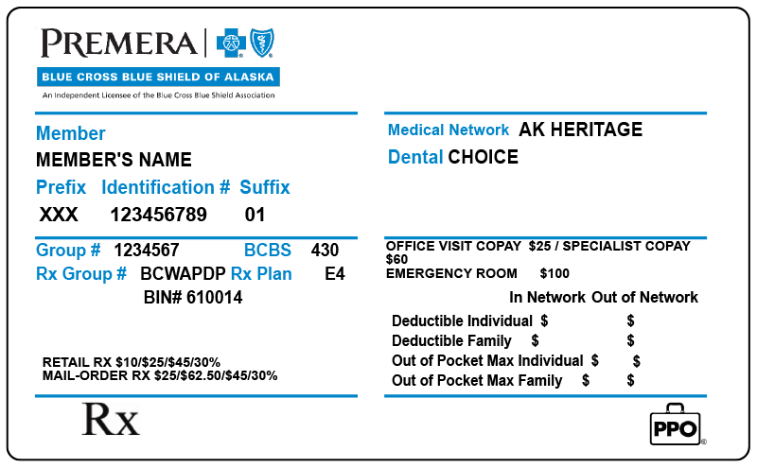
OPTIONAL SLIDE – REPLACE ID CARD IMAGE IF AVAILABLE
Your member ID card
For new Premera members
Your member ID card features important plan information. Providers need your member ID and group ID so they can correctly bill us for services.
You can expect your card to arrive in the mail by <DATE>.
Once a member, you can view a digital version of your ID card on the member dashboard when you sign in at premera.com.
Download the Premera mobile app to access your plan and your digital ID card on the go.
Member: Your name.
Identification #: This identifies you as a Premera member.
Rx Group #: Retail and mail-order pharmacies use this number to validate your drug coverage.
Medical network: The name of your plan network.
Rx Plan: Use this code to search for drugs in the Rx Search tool.
Cost shares: This area displays the cost share (the amount you pay) for certain services.
Create or sign into your account at premera.com

Slide 55

OPTIONAL SLIDE
Get access to your plan
One account helps you get the most from your plan
Visit premera.com and sign in to:
Get personalized health plan information
Search for in-network providers
Track your claims and deductible
View your digital ID card
Get estimates for cost of care and procedures
Access virtual care providers and programs
Get your EOBs delivered by email
Receive emails with helpful reminders and plan information
Create or sign into your account at premera.com

Slide 56
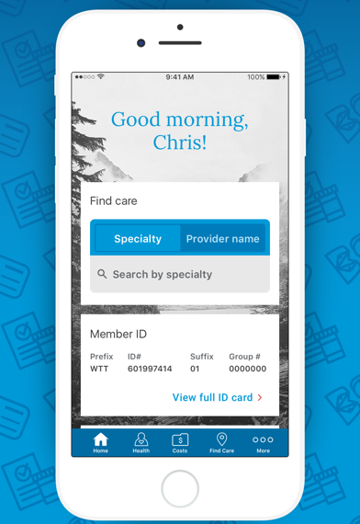
OPTIONAL SLIDE
Premera mobile app
Easy, convenient, on-the-go access to medical plan info right in your pocket.
Track your claims and deductible
View your digital ID card
Find in-network doctors and specialists
Access a list of your providers
Track preapproval status
View your prescriptions
Create or sign into your account on the Premera mobile app

Slide 57

Best-in-class customer service
We’re here to support you
Our members are at the center of all we do, and our team is ready to help with:
Benefit questions,
Claim status,
Finding a provider,
Translation services for non-English speakers,
And more!
Call us at 800-508-4722 (TTY: 711)
Monday through Friday, 5 a.m. to 8 p.m. Pacific Time
Or sign in to send us a message anytime.
Create or sign into your account today, at premera.com

Slide 58
Enroll now
Insert enrollment information and links here

Slide 59
Privacy, policies, & practices
NOTICE OF PRIVACY PRACTICES
At Premera Blue Cross Blue Shield of Alaska, we are committed to maintaining the confidentiality of your medical and financial information, which we refer to as your “personal information,” regardless of format: oral, written, or electronic. This Notice of Privacy Practices informs you about how we may collect, use, and disclose your personal information and your rights regarding that information. This Notice pertains to you and your covered dependents. Learn more: premera.com/visitor/privacy-practices
POLICIES & PRACTICES
Get information on:
Coverage – covered benefits and services, limitations and exclusions, costs, and more
Health plan information – how to access your personal health records, preapprovals, health and safety information, and more
Your rights and resources – language assistance, your right to appeal, request for reimbursement, understanding your explanation of benefits, and more
Learn more: premera.com/visitor/quick-help/policies-practices

